Slide 1

Cracking the Udemy Code: How Data Solves the Creator's Dilemma
An Interactive KNIME Analytics Story on Demand, Monetization, and Course Success
Name:Jilin Sebastian

Slide 2
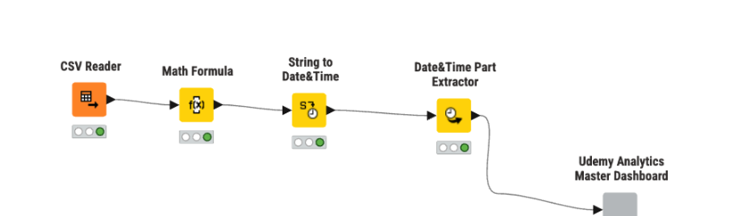

Chapter 1: Engineering the Lens — From Raw Data to Actionable Signals
Raw catalog records alone don't explain success—they contain hidden patterns, uncalculated revenues, and unparsed timestamps.
Ingesting Catalog Records: Imported 3,676+ courses across 4 distinct learning domains.
Unlocking the Revenue Metric: Calculated financial performance ($\text{Estimated Revenue}=\text{Price}×\text{Subscribers}$) to separate high-traffic hobby courses from true revenue engines.
Temporal Parsing: Converted unstructured timestamps into longitudinal time features (2011–2017).
Single-Frame Encapsulation: Packaged the entire analytical pipeline into an interactive Master Dashboard.

Slide 3
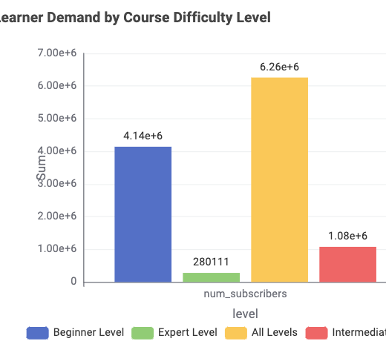
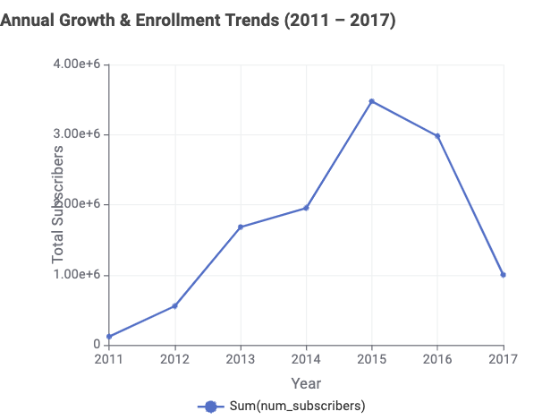
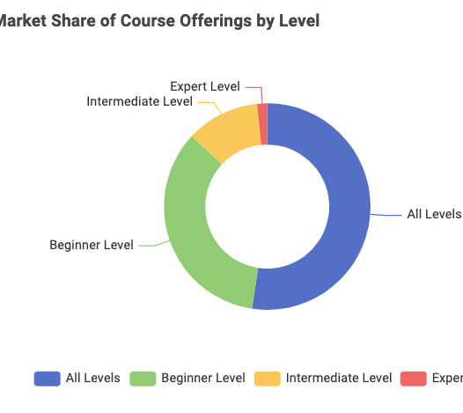
Chapter 2: The Landscape — Tracing the Surge & The Beginner Magnet
The Historic Gold Rush: Enrollments exploded between 2011 and 2015, peaking at over 3.5M annual subscribers before maturing into a steady ecosystem.
The Mass Market Reality: Over 85% of all learners congregate in "All Levels" (6.26M) and "Beginner Level" (4.14M) courses.
The Supply Alignment: Instructors have intuitively matched this demand by supplying primarily beginner-friendly content.
The Expert Paradox: "Expert Level" accounts for less than 5% of enrollments (280k)—a warning for mass-volume seekers, but an open blue ocean for high-ticket specialization.

Slide 4
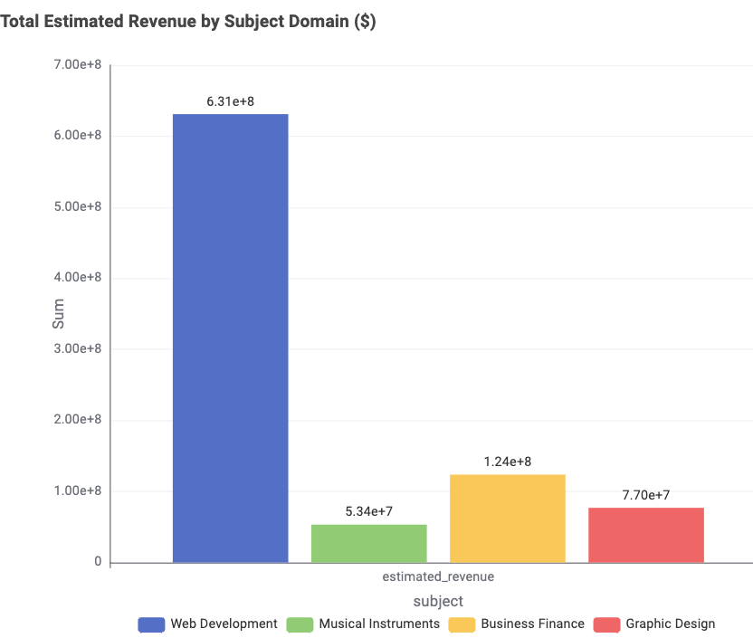
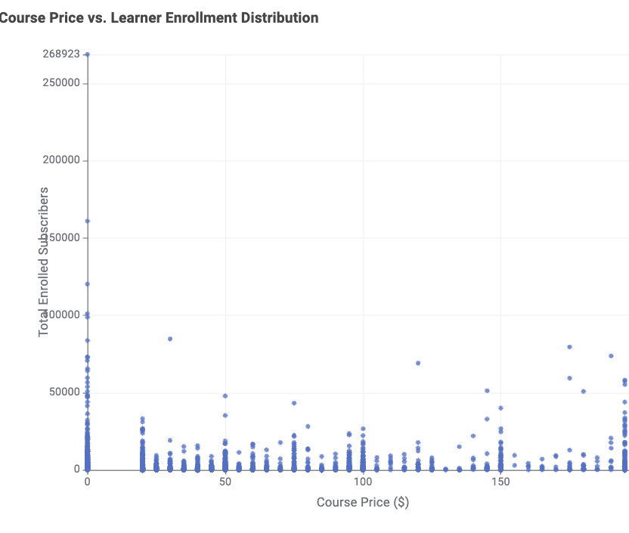
Chapter 3: The Economics — Tech Dominance & The Pricing Paradox
The Revenue Giant: Web Development is the economic powerhouse of Udemy, generating ~$631M—more than 5x the revenue of Business Finance (~$124M), Graphic Design (~$77M), and Music (~$53M) combined.
The Freemium Magnet: Zero-dollar ($0) courses capture extreme top-of-funnel traffic (spikes up to 268k students per course), proving invaluable for brand building.
The $200 Price Ceiling Myth: Instead of dropping off at premium prices, courses at the maximum tier ($200) maintain massive subscriber volumes, revealing strong willingness to pay for career-defining skills.
Strategic Sweet Spot: Pricing clusters tightly at standard anchor tiers ($20, $50, $100, $200), eliminating the need for complex, granular pricing strategies.

Slide 5
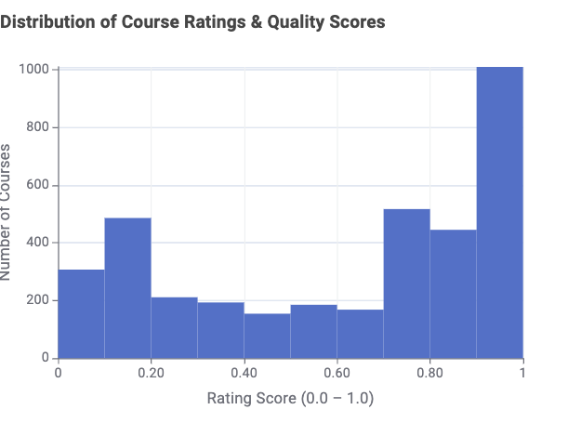
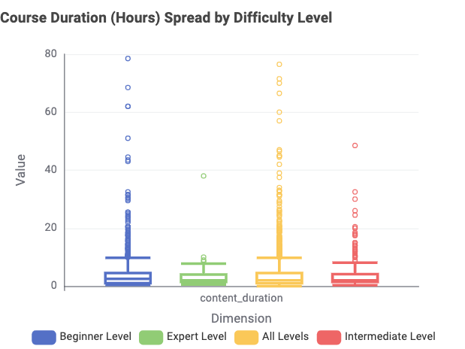
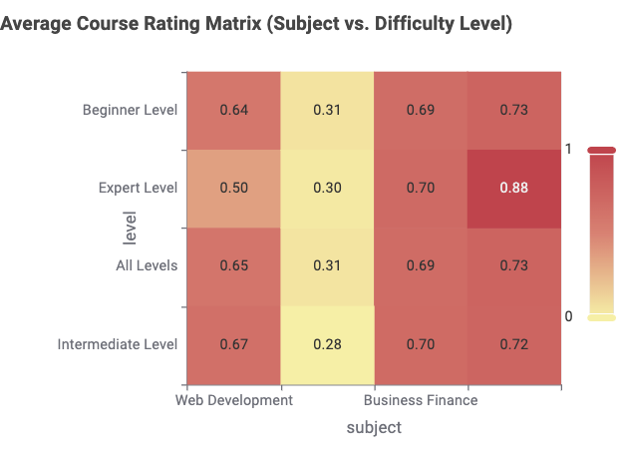
Chapter 4: The Quality Equation — The Masterclass Moat
High Student Satisfaction: Ratings display a strong positive skew, with the vast majority of courses maintaining satisfaction scores between 0.70 and 0.95+.
The Bite-Sized Standard: Across every difficulty level, the typical median course duration sits between 2 and 5 hours, keeping cognitive fatigue low.
The Outlier Effect: The highest-grossing courses consistently feature 30 to 80+ hours of video, creating an unassailable content moat.
Consistent Quality Across Tiers: The rating matrix proves that high ratings aren't reserved for short introductory courses; thorough, expert curricula maintain high review scores across all domains.

Slide 6
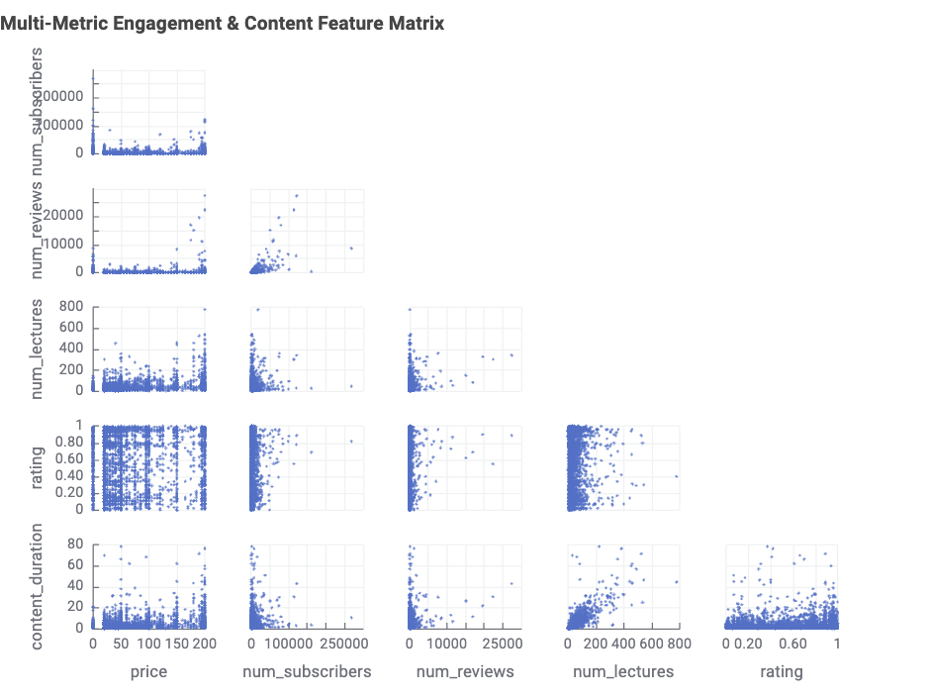
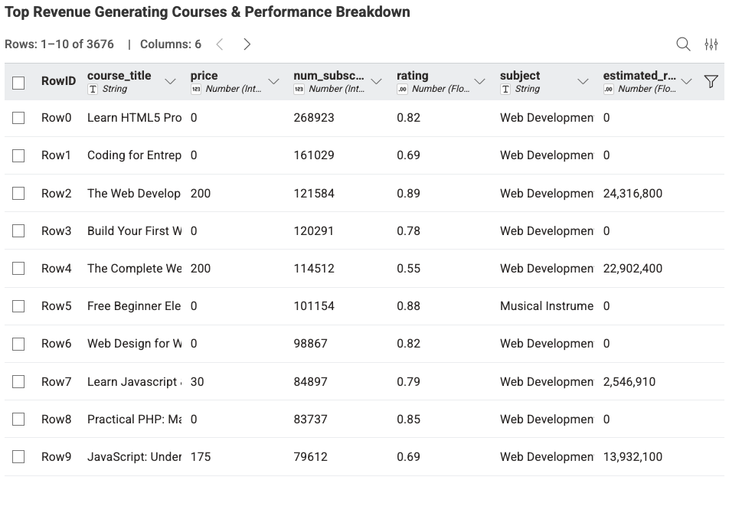
Chapter 5: The Flywheel — Social Proof & The Multimillion-Dollar Course
The Compounding Review Flywheel: The scatter matrix confirms that review count is the single strongest statistical driver of exponential subscriber growth.
Curriculum Density Shields Pricing: Higher lecture density directly insulates courses from price resistance, validating the $150–$200 premium tiers.
The Elite Catalog Tier: Top-ranking web development courses generate $13M to $24M+ each in gross estimated revenue.
Dynamic Record Inspection: The interactive table empowers stakeholders to filter and isolate the top 1% outliers from 3,676 total courses in real time.

Slide 7
Chapter 6: The Strategic Playbook — 4 Rules for Marketplace Dominance
1. Deploy a Freemium Acquisition Funnel: Publish a concise 1–2 hour free teaser course ($0) to capture massive top-of-funnel student volume, then cross-sell into a full premium masterclass.
2. Ride the High-ROI Tech Wave: Prioritize Web Development and applied software tracks, where learner demand and willingness to pay are over 5x higher than other domains.
3. Target the Beginner Core: Design for "Beginner" and "All Levels" to capture 85%+ of aggregate student demand, reserving "Expert" modules as high-ticket niche add-ons.
4. Ignite the Early Review Engine: Focus heavily on student onboarding in the first 30 days to build early review velocity, triggering the self-reinforcing social proof flywheel.

Slide 8
Epilogue: The Architecture — Powering Storytelling with KNIME
Workflow Modularity: Automated data ingestion, cleaning, feature transformation, and visualization inside an end-to-end reproducible pipeline.
Analytical Scale: Processed 3,676 course records across 4 primary learning domains with zero data leakage.
Dynamic Interactivity: Implemented responsive Nominal Row Filter Widgets linked across 8 chart types for real-time exploratory data analysis.
Production Ready: Encapsulated inside a self-contained KNIME Master Component, ready for deployment as an interactive web data app.

